Slide 1
CS 5602 Lec 18 HW04 Prep
George Markowsky
Computer Science Department
Missouri University of Science & Technology

Slide 2
Prelim 2
Prelim 2 is moving to 4/25. Our review will take place on Tuesday 4/23

Slide 3
Groups of Order 6
I want to give you a complete, clean version of the argument that there are only two groups of order 6
We know that there is always an abelian group of order k for each k, since you just pick (ℤ_{k},+)
We know that for order 6 we have the non-abelian group S₃.
The question we want to answer is, are there any other groups of order 6 besides these two?
We will break our search into 2 questions: asking for all abelian groups of order 6, and then asking for all non-abelian groups of order 6

Slide 4
The Abelian Case
Elements of a group of order 6 must have order 1, 2, 3, or 6 since these are the only numbers that divide 6
For both the abelian and non-abelian case we assume that no element has order 6, since otherwise we would get ℤ₆.
We claim that in the abelian and non-abelian case, there must be at least one element (this means at least two) of order 3.
Proof by contradiction. By a previous HW we know that if all elements have order two the group is abelian because if a, b ϵ G, then ab ϵ G, so a² = b² = (ab)² = 1, but this implies that ab = a(ab)(ab)b = a²bab² = ba. Since ab = ba ∀ a, b ϵ G, so there cannot be an non-abelian group having only elements of order 2

Slide 5
The Abelian Case
If we assume that there is an abelian group of order 6 where each non-identity has order 2, we have the following contradiction
Let a, b ϵ G be such that 1 ≠ a ≠ b ≠ 1. Such a and b exist since G has 6 elements. Since a² = b² = (ab)² = 1, it is easy to verify that H = { 1, a, b, ab} is a subgroup of G of order 4
This is impossible since 4 does not divide 6
Thus, we can assume that G is an abelian group of order 6, that has an element, a, of order 3, but no element of order 6
Let b ϵ G – { 1, a, a²}. It is clear that G = { 1, a, a², b, ba, ba² } and the elements are distinct. You can verify that they are distinct by looking at all equations setting one element = to another. For example, a² ≠ ba, else a = b by multiplying on the right by a⁻¹
Now we claim that b cannot have order 3

Slide 6
The Abelian Case
If b is of order 3, we have that b² ≠ 1, so the question is what can b² =?
It can't be one by assumption
b² ≠ b, ab, or a²b because by multiplying by b⁻¹ we would get that b = 1, a, or a², each of which is impossible
This would mean that b² = 1 which means that b is not of order 3
If b has order 2, then the element ab has order 6 since the powers of ab are 1, ab, a²b² = a², a³b³ = b, a⁴b⁴ = a, a⁵b⁵ = a²b, so ab has order 6 contradicting the assumption that no element of order 6 exists

Slide 7
The non-Abelian Case
Assume G is non-Abelian
We saw from an earlier argument that G must have an element of order 3
Let's call the element of order 3, a
Note that a² is also an element of order 3
Now pick b ϵ G – { 1, a, a² }
As before we see that G = { 1, a, a², b, ab, a²b } (or { 1, a, a², b, ba, ba²} )
Now we try to figure out what the multiplication looks like
One approach is to make a table to represent all possible multiplications – this is called a Cayley Table
Because we have a group, each element occurs exactly once in each row and each column

Slide 8
The non-Abelian Case
Cayley Table for non-Abelian Group of Order 6
 | 1 | a | a² | b | ab | a²b
1
a
a²
b
ab
a²b
Our strategy is to fill out the table.
We fill in the obvious elements
Our strategy is to fill out the table.

Slide 9
The non-Abelian Case
Cayley Table for non-Abelian Group of Order 6
 | 1 | a | a² | b | ab | a²b
1 | 1 | a | a² | b | ab | a²b
a
a²
b
ab
a²b
Justify!

Slide 10
The non-Abelian Case
Cayley Table for non-Abelian Group of Order 6
 | 1 | a | a² | b | ab | a²b
1 | 1 | a | a² | b | ab | a²b
a | a
a² | a²
b | b
ab | ab
a²b | a²b
Justify!

Slide 11
The non-Abelian Case
Cayley Table for non-Abelian Group of Order 6
 | 1 | a | a² | b | ab | a²b
1 | 1 | a | a² | b | ab | a²b
a | a | a² | 1
a² | a² | 1 | a
b | b
ab | ab
a²b | a²b
Justify!

Slide 12
The non-Abelian Case
Cayley Table for non-Abelian Group of Order 6
 | 1 | a | a² | b | ab | a²b
1 | 1 | a | a² | b | ab | a²b
a | a | a² | 1 | ab | a²b | b
a² | a² | 1 | a | a²b | b | ab
b | b
ab | ab
a²b | a²b
Justify!

Slide 13
The non-Abelian Case
Cayley Table for non-Abelian Group of Order 6
 | 1 | a | a² | b | ab | a²b
1 | 1 | a | a² | b | ab | a²b
a | a | a² | 1 | ab | a²b | b
a² | a² | 1 | a | a²b | b | ab
b | b | ba
ab | ab
a²b | a²b
What can ba = ?
Look at the a column – each element of G must appear exactly once
Can ba = b? No, else a = 1
Can ba = ab? No, else G would be abelian since everything is made up of a's and b's, if ba = ab everything would commute
Thus, ba = a²b

Slide 14
The non-Abelian Case
Cayley Table for non-Abelian Group of Order 6
 | 1 | a | a² | b | ab | a²b
1 | 1 | a | a² | b | ab | a²b
a | a | a² | 1 | ab | a²b | b
a² | a² | 1 | a | a²b | b | ab
b | b | a²b
ab | ab
a²b | a²b
Now we have the rule ba = a²b and we can complete the table!

Slide 15
The non-Abelian Case
Cayley Table for non-Abelian Group of Order 6
 | 1 | a | a² | b | ab | a²b
1 | 1 | a | a² | b | ab | a²b
a | a | a² | 1 | ab | a²b | b
a² | a² | 1 | a | a²b | b | ab
b | b | a²b
ab | ab | aba = a³b = b
a²b | a²b | ab
Now we have the rule ba = a²b and we can complete the table!

Slide 16
The non-Abelian Case
Cayley Table for non-Abelian Group of Order 6
 | 1 | a | a² | b | ab | a²b
1 | 1 | a | a² | b | ab | a²b
a | a | a² | 1 | ab | a²b | b
a² | a² | 1 | a | a²b | b | ab
b | b | a²b | ba² = ab
ab | ab | b | a²b
a²b | a²b | ab | b
Now we have the rule ba = a²b and we can complete the table!

Slide 17
The non-Abelian Case
Cayley Table for non-Abelian Group of Order 6
 | 1 | a | a² | b | ab | a²b
1 | 1 | a | a² | b | ab | a²b
a | a | a² | 1 | ab | a²b | b
a² | a² | 1 | a | a²b | b | ab
b | b | a²b | ba² = ab | b²
ab | ab | b | a²b | ab²
a²b | a²b | ab | b | a²b²
Now we have the rule ba = a²b and we can complete the table!

Slide 18
The non-Abelian Case
Cayley Table for non-Abelian Group of Order 6
 | 1 | a | a² | b | ab | a²b
1 | 1 | a | a² | b | ab | a²b
a | a | a² | 1 | ab | a²b | b
a² | a² | 1 | a | a²b | b | ab
b | b | a²b | ba² = ab | b² | a²b²
ab | ab | b | a²b | ab² | b²
a²b | a²b | ab | b | a²b² | ab²
Now we have the rule ba = a²b and we can complete the table!

Slide 19
The non-Abelian Case
Cayley Table for non-Abelian Group of Order 6
 | 1 | a | a² | b | ab | a²b
1 | 1 | a | a² | b | ab | a²b
a | a | a² | 1 | ab | a²b | b
a² | a² | 1 | a | a²b | b | ab
b | b | a²b | ba² = ab | b² | a²b² | ab²
ab | ab | b | a²b | ab² | b² | a²b²
a²b | a²b | ab | b | a²b² | ab² | b²
Now we have the rule ba = a²b and we can complete the table!
Clearly, {b², ab², a²b² } = { 1, a, a²}
In what order? What is b²?

Slide 20
What is b²?
b must have order 2 or 3
We want to prove that it has order 2
Proof by contradiction
Suppose b² ≠ 1 and b³ = 1
Note that in this case b⁴ = b
So if b² = a, then b = (b²)² = b⁴ = a² which is impossible
If b² = a², then b = a, which is impossible
Thus, b² = 1 and b must have order 2
We now see that there is only one Cayley, non-Abelian table of order 6

Slide 21
The non-Abelian Case
Cayley Table for non-Abelian Group of Order 6
 | 1 | a | a² | b | ab | a²b
1 | 1 | a | a² | b | ab | a²b
a | a | a² | 1 | ab | a²b | b
a² | a² | 1 | a | a²b | b | ab
b | b | a²b | ab | 1 | a² | a
ab | ab | b | a²b | a | 1 | a²
a²b | a²b | ab | b | a² | a | 1
This group is isomorphic to S₃ via any of the following 6 homomorphisms
(123) → a (12) → b
(123) → a (13) → b
(123) → a (23) → b
(132) → a (12) → b
(132) → a (13) → b
(132) → a (23) → b

Slide 22
Completing the Problem
You were asked, which of the groups of orders 1..7 could be found in S₄
Altogether we found 9 groups – 7 cyclic groups, the 4-Group {1, a, b, c}, and S₃
Clearly, the cyclic groups of order 1, 2, 3, and 4 are subgroups of S₄. Why?
The cyclic groups of orders 5 and 7 are not subgroups of S₄ since S₄ is of order 24 which is not divisible by 5 or 7
S₃ is a subgroup of S₄
To sum up, we have the following table

Slide 23
Completing the Problem
Group | Included (Reason)
{ 0 } | Yes, { (1)(2)(3)(4)} = { e }
{0, 1} | Yes, {e,{(12)(3)(4)} }
{0, 1, 2} | Yes, { e, {(123)(4)}, {(132)(4)} }
{0, 1, 2, 3} | Yes, {e, {(1234)}, {(13)(24)}, {(1432)}}
{ 1, a, b, c} ab = c, ac = b, bc = a, etc. | Yes, { e, {(12)}, {(34)}, {(12)(34)} }
{0, 1, 2, 3, 4} | No, 5 does not divide 24
{0, 1, 2, 3, 4, 5} | No, see next slide
S₃ | Yes, just take all permutations that have the cycle (4)
{0, 1, 2, 3, 4, 5, 6} | No, 7 does not divide 24

Slide 24
No Subgroup of S₄ Looks Like ℤ₆
We want to prove that no element of S₄ has order 6
Every element of S₄ has a representation by disjoint cycles
How can you make disjoint cycles with only four elements
You can either have one or two 2-cyles, one 3-cycle, or one 4-cycle
None of these elements have order 6
See table on the following slide

Slide 25
Orders of Elements of S₄
Order | Elements | Number
1 | e | 1
2 | {(12)} ,{(13)},{(14)},{(23)},{(24)},{(34)} {(12)(34)} ,{(13)(24)},{(14)(23)} | 9
3 | {(123)},{(132)},{(124)},{(142)},{(134)},{(143)},{(234)},{(243)} | 8
4 | {(1234)}, {(1243)}, {(1324)}, {(1342)}, {(1423)}, {(1432)} | 6
 | TOTAL Number of Elements | 24

Slide 26
HW 03 Problem 6
Let p be a prime.
(a) Let r and s be quadratic residues mod p. Prove that rs is a quadratic residue of p.
(b) Let r be a quadratic residue mod p and s a quadratic non-residue mod p. Prove that rs is a quadratic non-residue of p.
(c) Let r and s be quadratic non-residues mod p. Prove that rs is a quadratic residue mod p.
Prove L(rs,p) = L(r,p)L(s,p)

Slide 27
HW 03 Problem 6 (a)
r = x² (mod p) and s = y² (mod p) → rs = (xy)² (mod p) so rs is a quadratic residue

Slide 28
HW 03 Problem 6 (b)
Suppose r is a quadratic residue and s is a non-residue
We claim that rs is a non-residue
We will prove this by contradiction
Suppose rs is a quadratic residue, then rs = t = q² (mod p)
This means that s = r⁻¹t where t is a quadratic residue
If r is a quadratic residue, then so is r⁻¹, since r = x² → r⁻¹ = (x⁻¹)²
Thus, we would have s, a non-residue, equal to a product of residues, which must be a residue
This contradiction shows that rs is a non-residue!

Slide 29
HW 03 Problem 6 (c)
Note that G = (ℤ_{p}*,×) has p-1 elements
For p, a prime ≥ 3, p-1 is an even number
We have shown that G consists of (p-1)/2 residues and (p-1)/2 non-residues
Pick an element g ϵ G, how many solutions are there of xy = g for x, y ϵ G?
The answer is ∃ exactly |G| = p-1 solutions of xy = g ∀ g ϵ G
To see this note that ∀ x, g ϵ G, the equation xy = g has the unique solution y = x⁻¹g

Slide 30
HW 03 Problem 6 (c)
Let W = G × G, i.e., W is the set of ordered pairs (x,y) such that x, y ϵ G
Consider the function f: W → G given by f(x,y) = xy
Note that we said ∀ g ϵ G, |f⁻¹(g)| = |G| = p-1
Write G = R ∪ N where R are the residues and N the non-residues
G × G = R×R ∪ R×N ∪ N×R ∪ N×N
Each residue comes from (p-1) products, so the total number of products from W that map to residues must be |R|(p-1) = (p-1)²/2 and the number of products from W that map to residues must be |N|(p-1) = (p-1)²/2
We know that R×N and N×R map to N which gives us 2(p-1)²/4 = (p-1)²/2, so the remaining pairs, R×R and N×N must map to R
Thus the product of two non-residues must be a non-residue

Slide 31
HW 03 Problem 6 (d)
Consider the product L(r,p)L(s,p)
If r and s are residues, so is rs and L(r,p)L(s,p) = L(rs,p)
If one of (r,s) is a residue, and the other is a non-residue, then one of (L(r,p),L(s,p)) is 1 and the other is -1. rs is a non-residue so L(rs,p) = -1 = L(r,p)L(s,p)
Finally, if both r and s are non-residues, rs is a residue and L(r,p)L(s,p) = -1 × -1 = 1 = L(rs,p)
Thus, we have established the result!

Slide 32
HW 04 Problem 1
1. (10 points) Write a Python program that given n, computes the size of Sn, the prime factorization of n!, and the number of factors of n!. Output the result in the form (p1 ∗ ∗e1)(p2 ∗ ∗e2)...(pk ∗ ∗ek) where pi are the prime factors of n!. Use the Sieve of Eratosthenes in your code to figure out the prime factors. For example, if n = 4, S4 has 24 elements and the prime factorization should be outputted in the form (2**3)(3**1). Include values for n = 1,...,10 and n = 100.
Note that n! cannot contain any primes larger than n
Use the Sieve of Eratosthenes to find both the number of primes and the values of the primes ≤ n

Slide 33
HW 04 Problem 1
Don't compute n! try to factor it, since it is much easier to calculate the factorization of n! from the factorizations of 2, 3, …, n
See the Sieve Program on the next slide

Slide 34
Sieve
def Sieve(n):
if n < 2:
return [ ]
s = range(n+1)
s[0] = s[1] = - 1
for i in range(2,n+1):
if s[i] > 0:
for j in range(2*i,n+1,i):
s[j] = -1
os = [ ]
for i in range(2,n+1):
if s[i] > 0:
os.append(i)
return os
print Sieve(100)
[2, 3, 5, 7, 11, 13, 17, 19, 23, 29, 31, 37, 41, 43, 47, 53, 59, 61, 67, 71, 73, 79, 83, 89, 97]

Slide 35
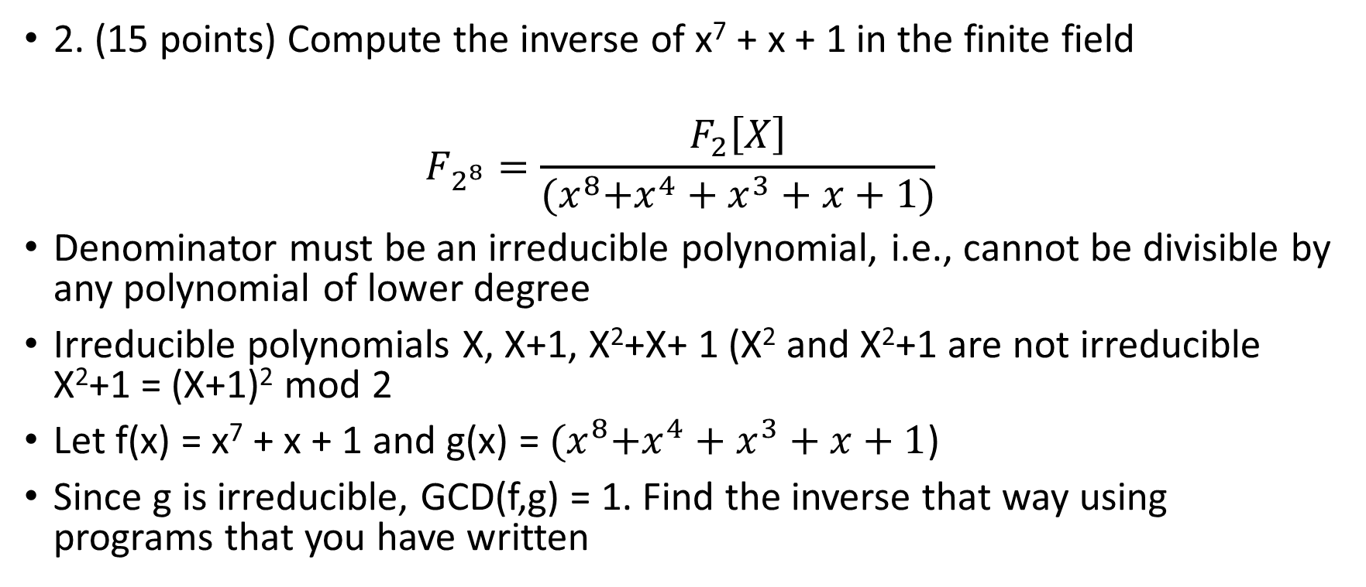
HW 04 Problem 2
2. (15 points) Compute the inverse of x⁷ + x + 1 in the finite field
$$F_{2^{8}}=\frac{F_{2}\left[X\right]}{{(x}^{8}+x^{4}+x^{3}+x+1)}$$
Denominator must be an irreducible polynomial, i.e., cannot be divisible by any polynomial of lower degree
Irreducible polynomials X, X+1, X²+X+ 1 (X² and X²+1 are not irreducible X²+1 = (X+1)² mod 2
Let f(x) = x⁷ + x + 1 and g(x) = ${(x}^{8}+x^{4}+x^{3}+x+1$)
Since g is irreducible, GCD(f,g) = 1. Find the inverse that way using programs that you have written

Slide 36
HW 04 Problem 3
3. (15 points) Define the Fibonacci numbers as follows: F₀ = 0, F₁ = 1, F_{n} = F_{n−1} + F_{n−2} . Suppose that you have two integers a and b such that when you compute the extended GCD of a and b, all the quotients (q_{i}) are equal to 1. Prove that a and b must be consecutive Fibonacci numbers. In particular, assume a > b, and a = q₁ × b + r. We are saying that q₁ = 1, and when we repeat the process with b and r, b = q₂ × r + r₂, then q₂ = 1, etc. Also prove the converse, that if a and b are consecutive Fibonacci numbers then the quotients are all equal to 1.

Slide 37
HW 04 Problem 3
Consider the pair 13 and 8
13 = 1*8 + 5
8 = 1*5 + 3
5 = 1*3 + 2
3 = 1*2 + 1
2 = 1*1 + 1
1 = 1*1

Slide 38
HW 04 Problem 4
4. (15 points) Show that if n is odd and has k distinct prime factors then the number of solutions of x² = 1 (mod n) is equal to 2^{k}.
Why is this suspicious?
Hint: Use the CRT!

Slide 39
HW 04 Problem 5
5. (15 points) Let p be a prime. Show that g is a generator of F_{p}∗ iff g^{p−1} = 1 (mod p) and g^{q} ≠ 1 (mod p) for all prime divisors q of p-1.
This is pretty much what we mean by a generator

Slide 40
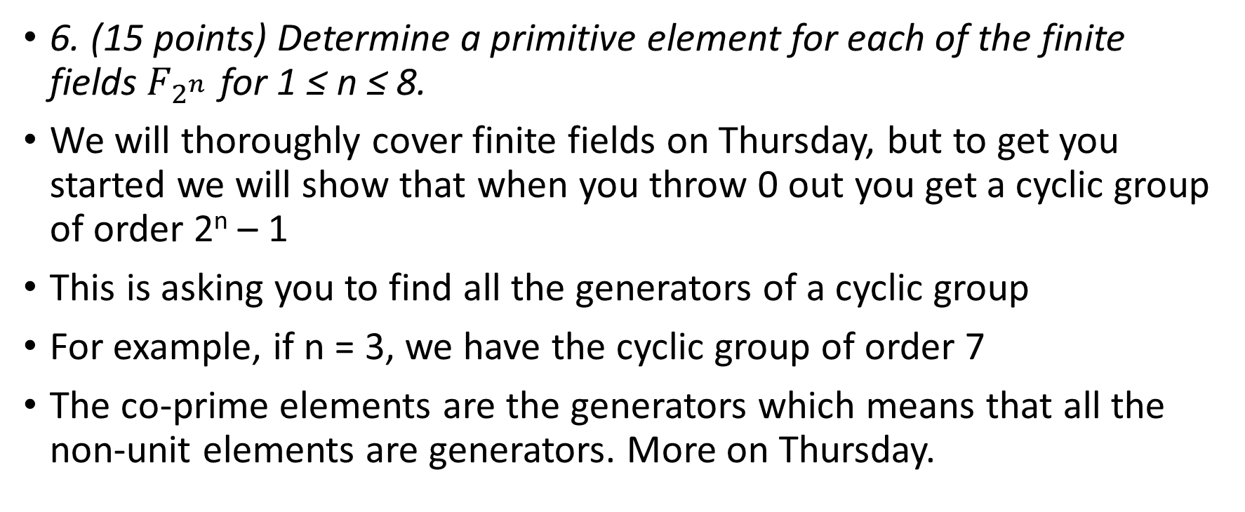
HW 04 Problem 6
6. (15 points) Determine a primitive element for each of the finite fields $F_{2^{n }}$for 1 ≤ n ≤ 8.
We will thoroughly cover finite fields on Thursday, but to get you started we will show that when you throw 0 out you get a cyclic group of order 2^{n} – 1
This is asking you to find all the generators of a cyclic group
For example, if n = 3, we have the cyclic group of order 7
The co-prime elements are the generators which means that all the non-unit elements are generators. More on Thursday.

Slide 41
HW 04 Problem 7
Follow the book on this one

